Slide 1
How States and Others are Using Medicare Data to Manage Populations -New Hampshire
Doris Lotz, MD, MPH
Chief Medical Officer
NH Department Health and Human Services
May 10, 2016

Slide 2
Introduction to MQIS

Slide 3
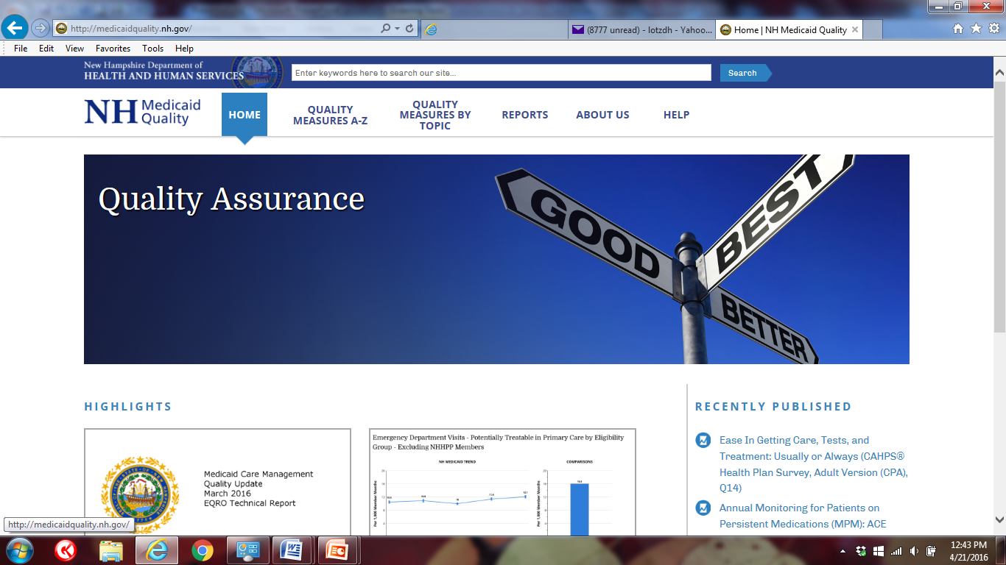
MQIS Demonstration
http://medicaidquality.nh.gov/

Slide 4
Medicare Data
“You can’t manage what you can’t measure”

Slide 5
CMS Innovation Accelerator Program (IAP) - Medicare/Medicaid Data Integration
Clean and incorporate the Medicare Dual eligible data into:
Medicaid Quality Information System
NH Comprehensive Health Information System
Comprehensive Beneficiary Profile
Incorporate active dual eligible management into managed care

Slide 6
Clean And Incorporate The Medicare Dual Eligible Data
Data standardization
Nomenclature differences across systems
Provider Identifier differences across systems
Member Identifier differences across systems
Note: one of the services FEi is offering is a Master Provider/Member Index
Claims data duplication
Note: since DHHS is responsible for payment of some of these services, there is the potential for duplicates where DHHS has the claim for payment, and then also receives it as part of the expanded COBA data feed

Slide 7
New Access to Data
Additional Medicare Part A and B services
Note: DHHS would not have records of many of these services since Medicaid would not be responsible for payment and would not see the claim
Part D Prescription Drug event data
Medicare Crosswalk files
Note: enables additional data standardization

Slide 8
Dual Eligible Beneficiary Profile
Profile will stratify across different focus areas, including, but not limited to:
Chronic conditions
Cost
Functional impairment
Living arrangements
Service utilization

Slide 9
Incorporate Active Dual Eligible Management Into Managed Care
MQIS will report out all the current managed care measures for the dual eligible subpopulation
MCO contract will require that one performance improvement project include and target the dual eligible population

Slide 10
Contact
Doris Lotz, MD, MPH
Chief Medical Officer
NH Dept Health and Human Services
dlotz@dhhs.state.nh.us

